Slide 1
Making Web pages
Discussion: have you ever made your own webpage/web site? If so, what where the tools involved, and what did you learn? If you haven’t, what would you create if you did make one?

Slide 2
Review
Internet is made up of protocols (TCP, IP, FTP, P stands are protocol)
protocols are standards in which we operate
The internet is designed to share and send data – mainly as files
Websites are series of
HTML Webpages (content)
CSS style sheets (look and feel)
Javascript programs (functionality)
while javascript sounds like java, it is not. Looks similar but very different language!
Browsers interrupt the HTML/CSS/Javascript and display the results!
Similar to how power point is looking at this power point file and displaying it!
But how do you ‘share your files’ so the world can view them as web pages?
First, you need a webserver (Apache being very common) that handles the TCP/IP protocols
Second, you need to understand file permissions!

Slide 3
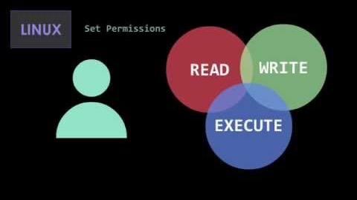
File Permissions in Linux

Slide 4
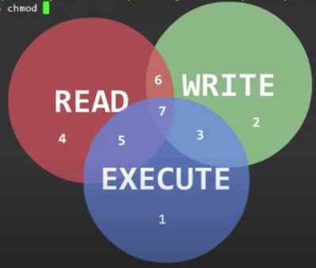
Let’s try this!
> ssh ename@denver.cs.colostate.edu
> ssh ename@boston.cs.colostate.edu
ssh into a CS machine
> pwd
> mkdir public_html
if it doesn’t already exist.
make sure it is all lower case, the underscore matters
Apache looks for this directly to display webpages!
> cd public_html
> nano
or pico

Slide 5
Writing HTML
First, write out the template!
<head>
contains data about the page
<body>
contains the actual content! you will work here
In the <body>
<h1></h1> give your page a title
<p>add a paragraph or two</p>
Save the file as
index.html
(note if you already have a website setup, do all this in a subdirectory)
Now, let’s try it in the browser
http://www.cs.colostate.edu/~ename/
<!DOCTYPE html>
<html> <head> <title></title>
</head>
<body>
</body>
</html>
Seem familiar?

Slide 6
Did it work?
For most of you, it didn’t!!
Why?
You didn’t set it so the whole world can see it!!!
Permissions!
Back on the linux command line
> ls –l
check the permissions on index.html
> chmod ___ index.html
What value goes in the blank? we want
owner: read,write
group: read
world: read
Go back to the browser, refresh the page!
Notes:
chmod 644 index.html

Slide 7
Did it work??
For most – no it *still did not*
sigh!
Ok, so we know the world can see the file
But…. is the world able to see public_html?
probably not!!
> cd ..
move up a level
> ls –l
check the permissions on public_html
> chmod ____ public_html
owner: read,write,execute
group: read,execute
world: read, execute
For directories, we want execute permission!
Notes:
chmod 755 public_html
technically, we can make it 711 - both are valid, but 755 is more common as it allows a directory listing if the file isn’t found

Slide 8
Why does this matter?
try {
}catch (FileNotFoundException fex) { /// give one set of feedback }catch(IOException iox) { /// give a different set of feedback }
Exceptions!!
You have a lot of power to change file permissions
What if your program needed to access a file it can’t read to?
What if you are trying to write a file you can’t write to?
FileNotFoundException
Self explanatory
IOException
happens when errors happen when interacting with the disk
Such as, not having permission to write / read elements of a disk.
Understanding permissions also helps you understand
why you would need to try/catch blocks of your code
things programmers need to watch for
you will deal with this more in the future

Slide 9
Class project
Have fun with the website!!
Try some commands – <table> (remember p4), <strong></strong>, etc
Maybe create two pages and link them!!
<a href=“yoursecondpage.html”>my link</a>
Show off to others what you are doing

Slide 10
Finally – read the manual
> man chmod
type q to leave the manual page
> man ls
No one remembers all the options for the linux commands, we all read/skim man (manual)

Slide 11
Recursion Practice
Together, we will step through an example of how recursion is useful.
Example Problem: The Fibonacci Sequence
Step 1: Understand how the problem works.
0, 1, 1, 2, 3, 5, 8 …
Each number the sum of the previous 2 numbers
Step 2: Identify the base cases
Base Case: where the recursion ends
0 and 1
Step 3: Identify the recursive case
Recursive case: What operation is being performed
Current number = previous number + previous previous number
Step 4: Check your understanding -> Draw the tree

Slide 12
Abstract Classes
Can view abstract classes as halfway between an interface and a concrete class
Some implemented behavior (like a class), and some method stubs (like an interface)
Rules
Cannot create an object of an abstract class type
Can inherit from (extend) an abstract class, BUT
Must implement all method stubs in child class, OR
Child class must also be abstract
Abstract classes may have constructors you can use, BUT
They can only be used to construct an object for a concrete subclass
Why are they useful?
Share code among closely related subclasses while also defining what is different about the subclasses (method stubs)

